Slide 1
EdTech Analysis
2023
Uplisu

Slide 2
Introduction
EdTech Analysis…
In this Analysis we are about to find out the Cluster Wise Active users, In Active and Fairly Active Users.

Slide 3
Data

Slide 4
Data
Data collected as a Cluster wise
Preprocess:
Cleaned the data using python pandas
Analyzed Data using EDA to find the correlation

Slide 5
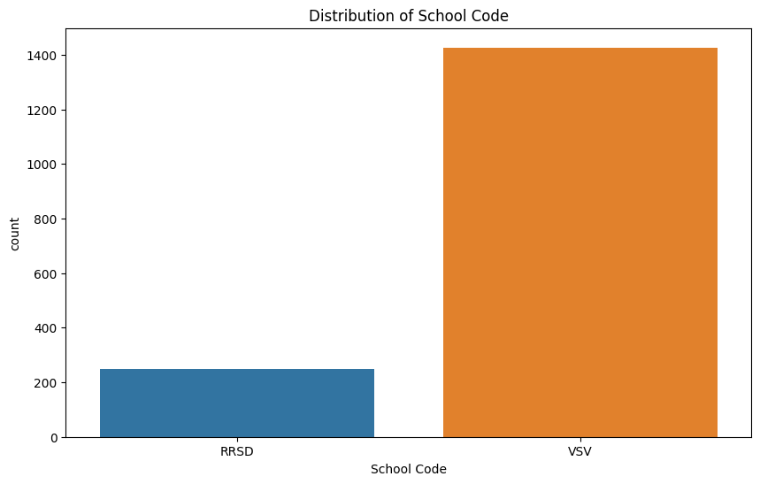
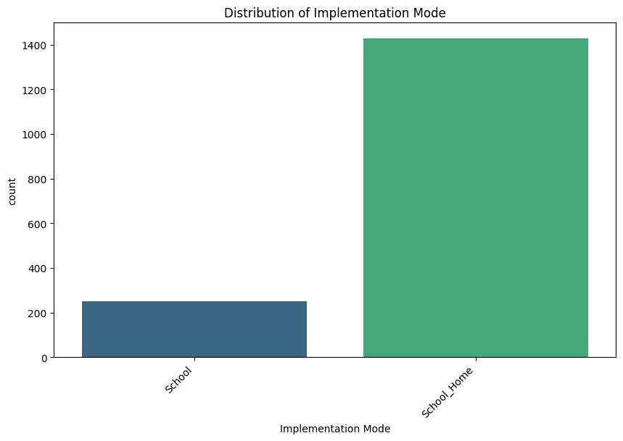
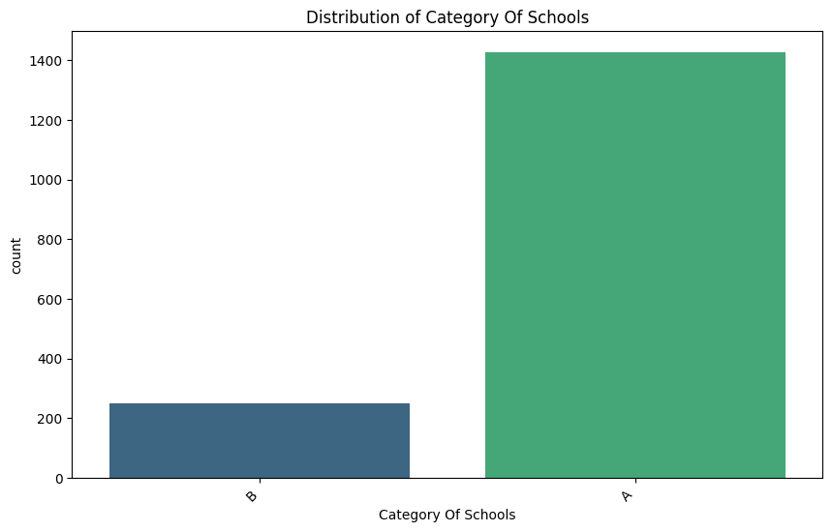
Sample EDA Images
20XX

Slide 6
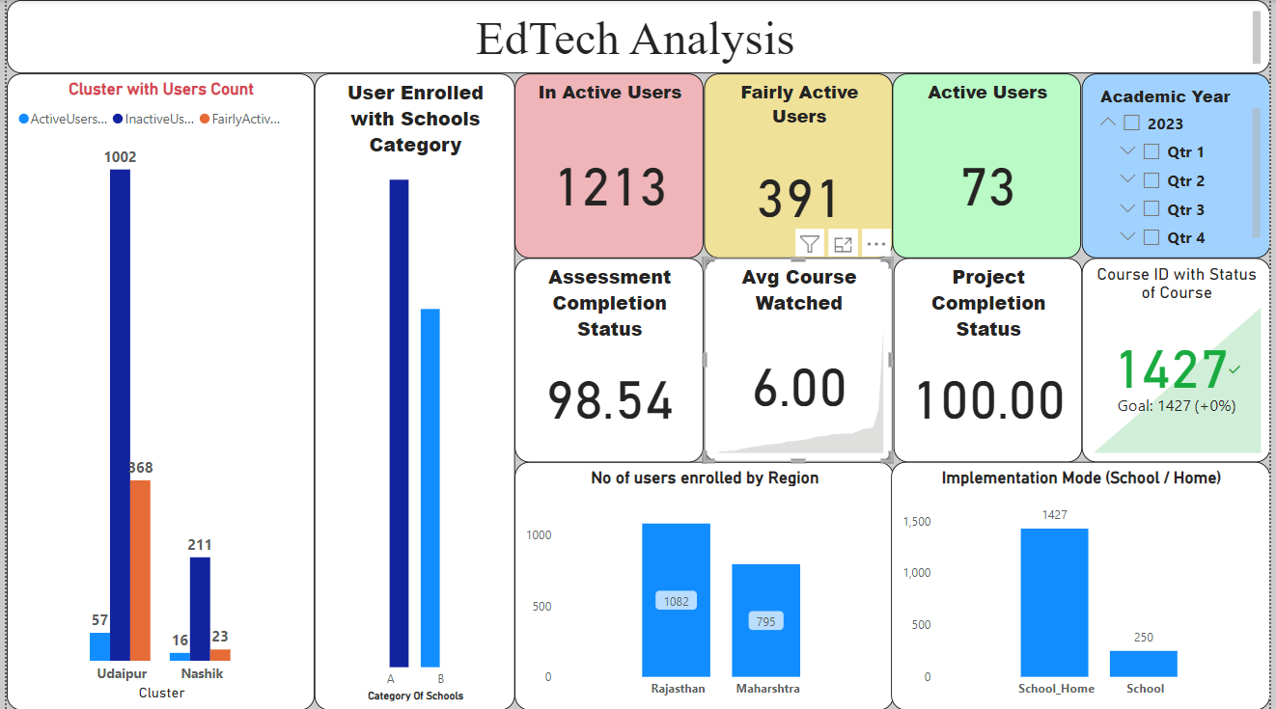
Dashboard Image

Slide 7
Insights
Active Users – 73, Fairly Active Users – 391, Inactive Users – 1213.
According to the Analysis Active Users in the 4th Quarter of the year is Most High, comparatively other Quarters.
Numbers are less enrolled the Courses in the first Quarter, so we can concentrate on Post Exam Courses like NEET, IIT – coaching Trainings.
Power BI – Dashboard link (uploaded in my Github) - https://github.com/robertjones-987/EdTech_Analysis.git

Slide 8
THANK YOU!
2023
Robert Jones

